Slide 2
THE MECHANICS OF BREATHING
Human Biology

Slide 3
Breathing
Breathing consists of two phases:
Inspiration / inhalation the process of taking in air
Expiration / exhalation the process of blowing out air

Slide 4
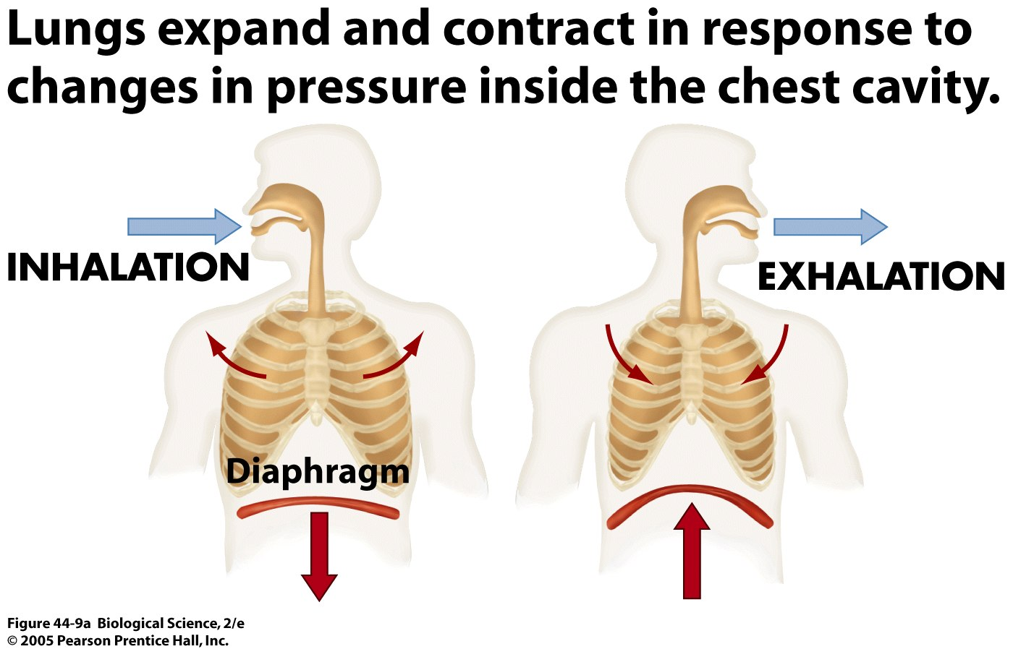

Slide 5
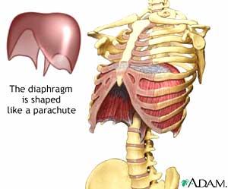
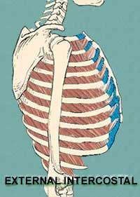
The diaphragm and the intercostals are muscles that contract to create a greater volume in the thoracic cavity
THE LUNGS DO NOT CONTAIN ANY MUSCLES THAT CHANGE THE VOLUME OF THE LUNG

Slide 6
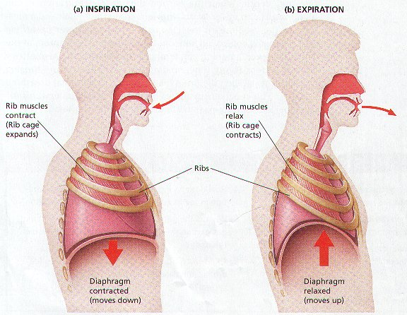
INSPIRATION (Inhaling)
Intercostal Muscles – contract
Contraction moves the rib cage and sternum upwards and outwards. The width of the chest increases from side to side and front to back.
Diaphragm – contracts and lowers
These two movements has the effect of increasing the internal volume of the chest – creating an area of low pressure.

Slide 7
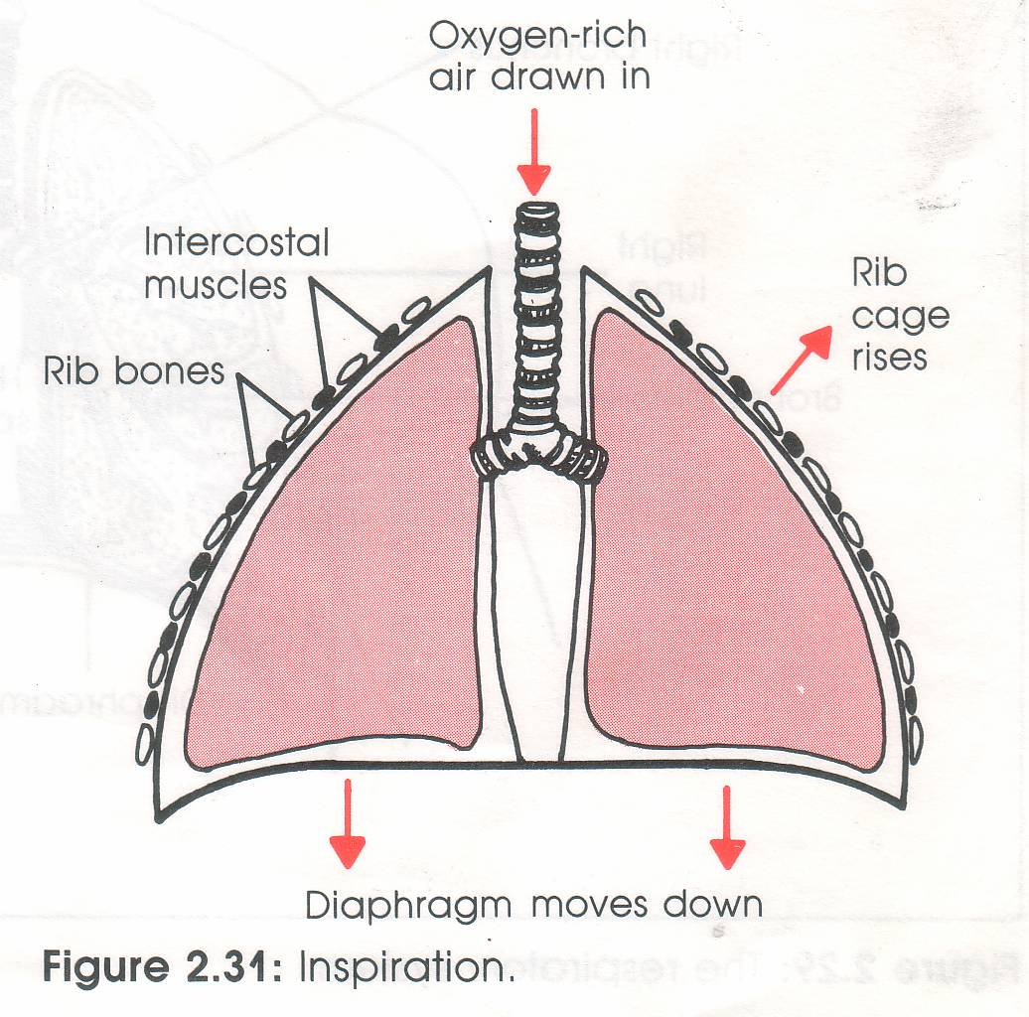
INSPIRATION (Inhaling)
Air pressure and movement
Air from the outside (area of higher pressure) is drawn into the chest cavity (area of lower pressure).

Slide 8
EXPIRATION (exhaling)
Intercostal Muscles – relax
Relaxing moves the rib cage and sternum downwards and inwards. The width of the chest decreases from side to side and front to back.
Diaphragm – relaxes and is raised
These two movements has the effect of decreasing the internal volume of the chest – creating an area of high pressure.

Slide 9
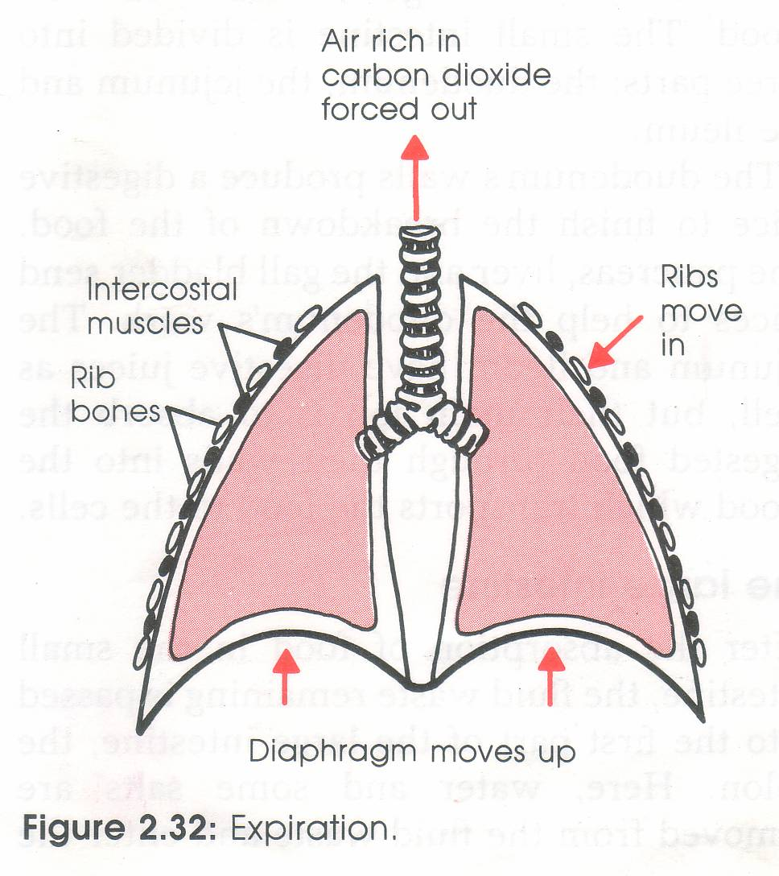
EXPIRATION (exhaling)
Air pressure and movement
Air from the inside (area of higher pressure) is pushed out of the chest cavity (area of lower pressure).

Slide 10
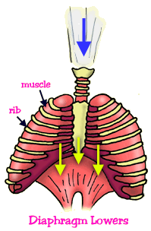
INSPIRATON SUMMARY
Intercostal muscles contract
Rib cage up and out
Diaphragm contracts and moves down
Increased space
Air sucked in

Slide 11
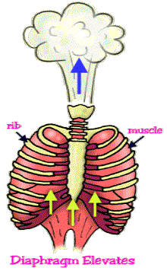
EXPIRATION SUMMARY
Intercostal muscles relax
Rib cage down and in
Diaphragm relaxes and moves up
Decreased space
Air pushed out

Slide 12
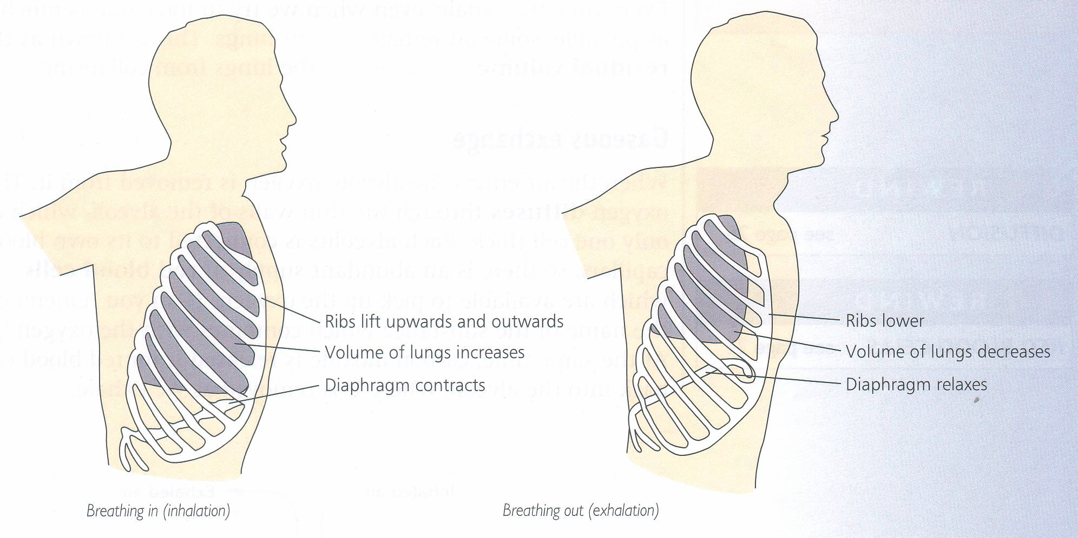

Slide 13
WHAT WE BREATHE
As well as breathing in oxygen, we also breathe out a lot of oxygen.
This is most important when we give mouth to mouth resuscitation.
The air we INHALE contains 20% oxygen and 0.04% carbon dioxide.

Slide 14
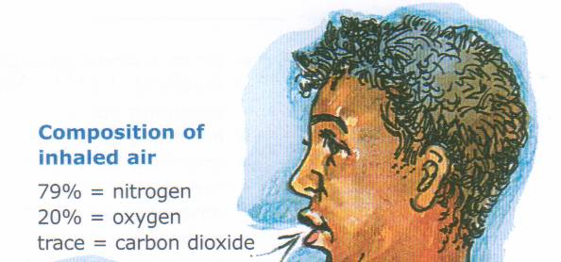
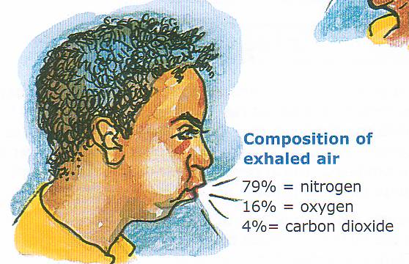
2. The air we EXHALE contains 16% oxygen and 4% carbon dioxide.

Slide 15
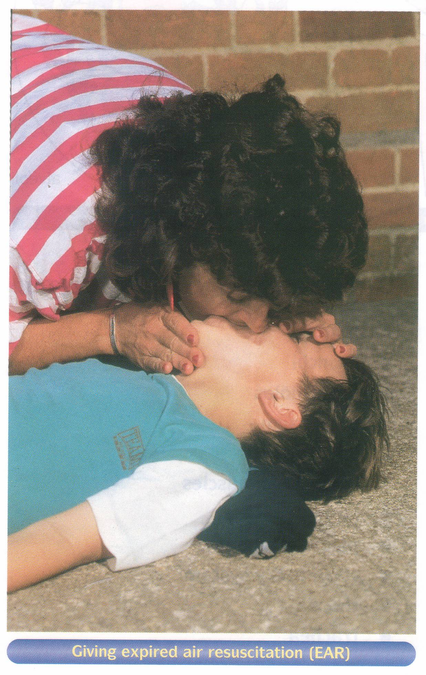
This is why we can give the “kiss of life”

Slide 16
External respiration
Partial pressure (mmHg)
 | Alveolar air | Deoxygenated blood | Oxygenated blood
Oxygen | 100 | 40 | 100
Carbon Dioxide | 40 | 44 | 40
Breathing maintains the correct concentration of gases in the lungs
Concentration gradient

Slide 17
